Slide 1
Regulations as a new Dimension in Business Intelligence
Continuous Improvement of Regulations and Compliance by Complementing Business Intelligence Tools with Goal Analysis
Omar Badreddin
obadr024@uottawa.ca

Slide 2

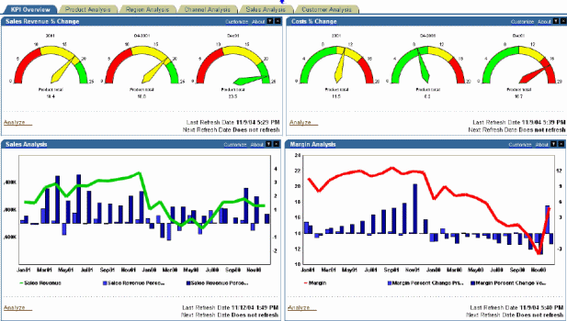
From Regulations to Business Intelligence

Slide 3
The Problem
Regulations are not well structured
Hard to measure compliance
Regulations overlap, compliment and conflict with each other
Regulations prescriptive, intentions are implicit.
Cannot reason about regulations like we reason about other dimensions “Location, Time, Measure,..”

Slide 4
The Approach
Rewrite regulations so they are outcome based
  The intention behind legislation become explicit
Identify regulations structure
  Tree structure?
Identify relationships between each regulations
  R1 & R2, R1 OR R2.
Identify weights for each regulations
Identify KPIs for each regulation
  Typically available from inspection or assessment sheets.
Calculate compliance of each regulation (and their composition) using Goal Modeling.

Slide 5
The Outcome
Compliant (Yes/No) -> Level of compliance
Use BI techniques to reason about compliance
  Drill down
  Dashboards
Identify Compliance patterns
  Also focus on improving regulations and not only compliance.

Slide 6
The How
1 and 4 Outcome based regulations and weights
Domain experts (layers, Operations)
2 and 3 Regulation structure and composition
Parsing regulation source text
5 Identify KPIs
Inspection, Assessments, Enforcement manual

Slide 7
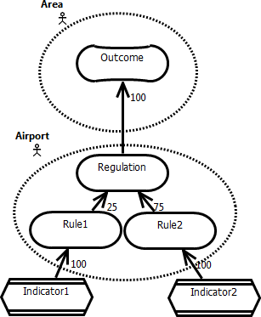
The How
5 Calculate compliance
Actor
Contribution
Goal
Indicator

Slide 8
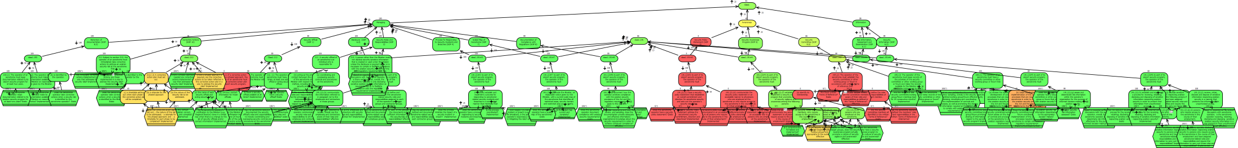
Regulations as a Goal Model

Slide 9
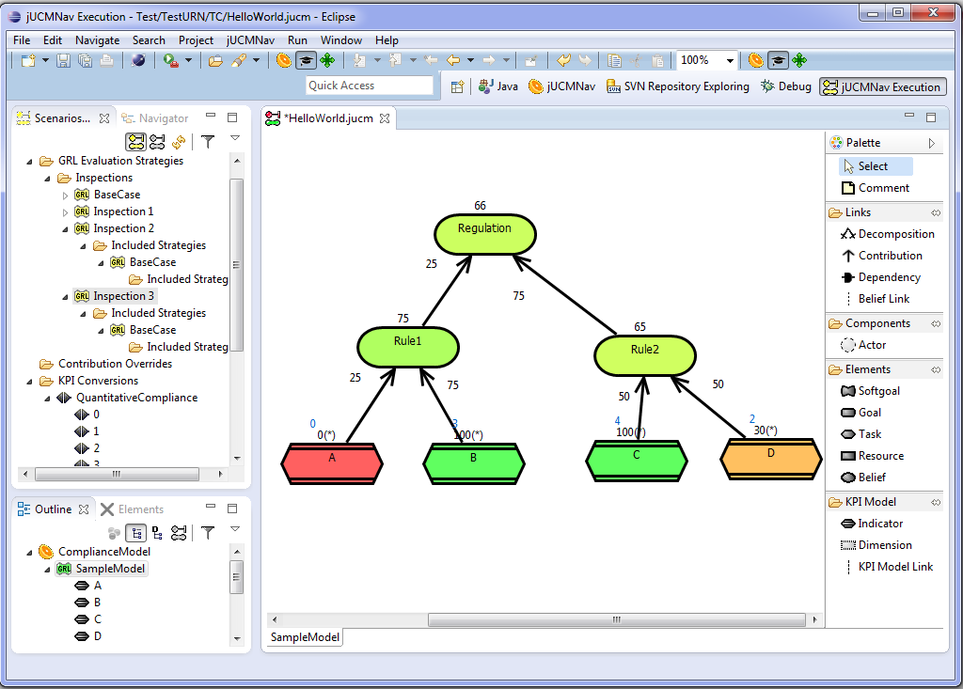

Slide 10
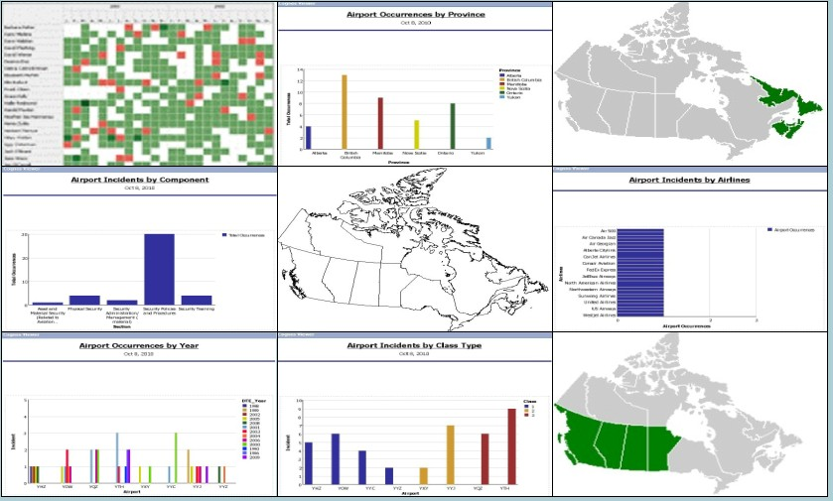
Regulations in BI
[Note: fake data and diagrams used here]

Slide 11
Some Lessons
Modeling is beneficial
  Removes ambiguities
  Helps identify indicators
Iterate modeling and regulation drafting

Slide 12


